Slide 1
Security Health Improvement Program (SHIP) HealthCheck

Slide 2
Agenda
HealthCheck overview
AWS security best practices
Introduction to core AWS security services
Choosing a path to ongoing improvements

Slide 3








SHIP HealthCheck
Overview
A SHIP HealthCheck can improve AWS security health by highlighting AWS security best practices, accelerating adoption of core AWS Security Services, and identify resources for continuous improvement
Security Best Practices
Core Security Services
Continuous Improvement
AWS Security Hub
AWS Key Management Service
AWS Professional Services
AWS Support
AWS Trusted Advisor
Exposed Access Keys
MFA on Root Account
AWS CloudTrail Logging
IAM Access Key Rotation
IAM Password Policy
Security Groups
Amazon GuardDuty
AWS WAF

Slide 4
Executive Summary
Assessment | Findings | Remediation Effort | AWS Top 10¹
Accurate Account Info | Manual | Low | 1
MFA on Root User | [+iam_root_mfa_enabled+] | Low | 2
Exposed Access Keys | Trusted Advisor Check | Medium | 3
Unrestricted Security Groups | [+ec2_securitygroup_allow_ingress_from_internet_to_any_port+] | Medium | 4
S3 Bucket Public access | [+s3_bucket_public_access+] | Low | 5
CloudTrail Logging multi-region | [+cloudtrail_multi_region_enabled+] | Low | 6
Validate IAM Roles | Manual | Low | 7
GuardDuty Inactive Accounts/Regions | [+guardduty_is_enabled+] | Medium | 8
IAM Access Key Rotation | [+iam_rotate_access_key_90_days+] | High | 9
Be Involved in Development Cycle | Manual | High | 10
IAM Password Policy | [+iam_password_policy+] | Low | N/A
AWS Config Inactive Accounts/Regions | [+config_recorder_all_regions_enabled+] | Low | N/A
ELB Listener Security | Trusted Advisor Check | Medium | N/A
AWS Lambda Functions Using Deprecated Runtimes | [+awslambda_function_using_supported_runtimes+] | Medium | N/A
Accounts Analyzed | Checks performed
[+unique_accounts+] | [+unique_checks+]
Severity | Total
Critical | [+critical_severity_count+]
High | [+high_severity_count+]
Medium | [+medium_severity_count+]
Low | [+low_severity_count+]
Total | [+total_findings+]
¹ Top 10 alignment refers to Steve Schmidt's Top 10 recomendations.

Slide 5
AWS Security Best Practices

Slide 6
Security items to improve your AWS security health
Accurate account info
Use MFA
No hard-coding secrets
Limit security groups
Intentional data policies
6. Centralize AWS CloudTrail logs
7. Validate IAM roles
8. Take action on Amazon GuardDuty findings
9. Rotate your keys
10. Being involved in dev cycle

Slide 7
Accurate Account Info
Manual Investigation
Description
This is a manual check to ensure that all account information is accurate and well filled out. Ensure email addresses used are regularly checked.
Risk
When AWS needs to contact you about your AWS account, we use the contact information defined in the AWS Management Console, including the email address used to create the account and those listed under Alternate Contacts. If this information is incorrect, it would be very difficult to validate ownership of the account should the need arise. Also, AWS sends notifications and other critical communications through emails specified.
Recommendation
All email addresses should be set up to go to aliases that are not dependent on a single person. You should also have a process for regularly checking that these email addresses work, and that you are responding to emails—especially security notifications you might receive from abuse@amazon.com. Learn how to set the alternate contacts to help ensure someone is receiving important messages, even when you are unavailable.
AWS Top 10 Alignment: 1
Level of Effort: Low
AWS Service: IAM
AWS Documentation
AWS Control Tower
Managing Alternate Contacts
Steps to Manually Verify Finding:
Login AWS Console as root
Click on the upper right hand corner for the account
Select “My Account”

Slide 8
MFA on Root Account
Description
For increased security, we recommend that you protect your account by using MFA, which requires a user to enter a unique authentication code from their MFA hardware or virtual device when interacting with the AWS console.
Risk
Without MFA, the root account can be logged in from anyone around the world. With a hardware MFA token, it ensures it can only be logged in from where the MFA token is located.
Recommendation
(1) Enable MFA for root accounts and (2) Use Service Control Policies (SCPs) to block Root Credentials if using AWS Organizations or Landing Zones to vend accounts.
AWS Top 10 Alignment: 2
Level of Effort: Low
AWS Service: IAM
AWS Documentation
MFA in AWS
Steps to Manually Verify Finding:
Login AWS Console with account ID listed in the finding
Search for IAM and open
Upper right corner, click on the account number
Select “My credentials”
Scroll down until you see MFA
Beginning in mid-2024, MFA will be required for the root user of an AWS Organization management account. https://aws.amazon.com/blogs/security/security-by-design-aws-to-enhance-mfa-requirements-in-2024/

Slide 9
Exposed Access Keys
Trusted Advisor Check
Description
A failed check in Trusted Advisor is based on a check conducted to popular code repositories for access keys that have been exposed to the public and for irregular Amazon Elastic Compute Cloud (Amazon EC2) usage that could be the result of a compromised access key. Exposed access keys pose a security risk to your account and other users, could lead to excessive charges from unauthorized activity or abuse, and violate the AWS Customer Agreement. If your access key is exposed, take immediate action to secure your account.
Risk
Exposed Access keys indicates the keys are either found in a public repository or the keys appear to be used abnormally. If the keys are in a public repository, it is likely someone outside of your organization is using the keys in attempt to potentially exfiltrate data or abuse AWS resources such as mining of cryptocurrency.
Recommendation
Disable the affected access key immediately. Check your account for unauthorized usage.
AWS Top 10 Alignment: 3
Level of Effort: Medium
AWS Service: IAM
AWS Documentation
How to Rotate Access Keys
Steps to Manually Verify Finding:
Login AWS Console
Search for Trusted Advisor and open
Click on “Security” on the left hand side
Search for the specific assessment
Click on the Assessment Name to expand
A list of all resources and potential causes will be listed

Slide 10
Security Groups – Unrestricted Access
Description
Unrestricted access increases opportunities for malicious activity (hacking, denial-of-service attacks, loss of data).
Risk
Security Groups with 0.0.0.0/0 or ::/0 configuration allows any traffic to reach the AWS resource. This is effectively turning off the firewall. Such a configuration could allow network reachability from any resource that can route to it.
Recommendation
Restrict access to only those IP addresses and security groups that require it. Be sure to delete overly permissive rules after creating rules that are more restrictive. You can also use SSM Session Manager to allow SSH access to machines without needing to keep port 22 open.
AWS Top 10 Alignment: 4
Level of Effort: Medium
AWS Service: EC2
AWS Documentation
AWS Config
AWS Firewall Manager
Monitoring Changes and Calls to Security Groups
Steps to Manually Verify Finding:
Login AWS Console
Search for Trusted Advisor and open
Click on “Security” on the left hand side
Search for the specific assessment
Click on the Assessment Name to expand
A list of all resources and potential causes will be listed

Slide 11
Amazon S3 Bucket Permissions
Description
Amazon Simple Storage Service (Amazon S3) buckets should not have open access permissions. This check examines explicit bucket permissions and associated bucket policies that might override the bucket permissions.
Risk
S3 bucket is an object data store which are common targets for data exfiltration or ransomware attacks. Bucket permissions that grant open access to everyone can result in higher than expected charges and unintentionally data exposure. Bucket permissions that grant Upload/Delete access to everyone create potential security vulnerabilities by allowing anyone to add, modify, or remove items in a bucket.
Recommendation
Use S3 Block Public Access to easily set up centralized controls to limit public access to Amazon S3 resources that are enforced regardless of how the resources are created.
Use S3 Access Analyzer to determine if open access is truly needed. If not, update the bucket permissions to restrict access to the owner or specific users.
AWS Top 10 Alignment: 5
Level of Effort: Low
AWS Service: S3
AWS Documentation
S3 Access Analyzer
S3 Block Public Access
Steps to Manually Verify Finding:
Login AWS Console
Search for Trusted Advisor and open
Click on “Security” on the left hand side
Search for the specific assessment
Click on the Assessment Name to expand
A list of all resources and potential causes will be listed

Slide 12
Centralize CloudTrail logs
Description
CloudTrail provides increased visibility into activity in your AWS account by recording information about AWS API calls made on the account. You can use these logs to determine, for example, what actions a particular user has taken during a specified time period or which users have taken actions on a particular resource during a specified time period.
Risk
CloudTrail provides a detailed audit log of API calls inside an AWS account. If the logs are not being delivered or CloudTrail is not configured, there will be no logs available for auditing purposes or investigations.
Recommendation
Enable AWS Organizations CloudTrail. Centralized Collection of AWS CloudTrail events allow you to understand what is happening in your AWS accounts.
Integrate with Amazon CloudWatch Logs to monitor and receive alerts for specific events captured by CloudTrail. For example, failed AWS Management Console sign-in events or use of Root user.
AWS Top 10 Alignment: 6
Level of Effort: Low
AWS Service: CloudTrail
AWS Documentation
Creating Organization Trail
Steps to Manually Verify Finding:
Login AWS Console
Search for Trusted Advisor and open
Click on “Security” on the left hand side
Search for the specific assessment
Click on the Assessment Name to expand
A list of all resources and potential causes will be listed

Slide 13
Validate IAM Roles
Manual Investigation
Description
This is a manual check to identify unused IAM resources such as IAM Roles.
Risk
As you operate your AWS accounts to iterate and build capability, you may end up creating multiple IAM roles that you discover later you don’t need. Unused accounts and roles increase the attack surface area.
Recommendation
Use AWS IAM Access Analyzer to review access to your internal AWS resources and determine where you have shared access outside your AWS accounts.
Continuously monitor unused IAM roles with AWS Config.
AWS Top 10 Alignment: 7
Level of Effort: Low
AWS Service: IAM
AWS Documentation
IAM Access Analyzer
Monitoring Unused IAM roles with Config
Steps to Manually Verify Finding:
Login AWS Console
Search for IAM and open
Open “Credential report”
Look for last login

Slide 14
GuardDuty Inactive Accounts/Regions
Description
Amazon GuardDuty is a threat detection service that continuously monitors your AWS accounts and workloads for malicious activity and delivers detailed security findings for visibility and remediation.
Risk
GuardDuty Protection Plans:
Account and Instance compromise: Detect known and unknown threats like cryptocurrency mining, crypto-malware, unusual API calls.
S3 Protection: Identify potential security risks for data within your Amazon S3 buckets.
EKS Protection: Threat detection coverage to help you protect Amazon EKS clusters within your AWS environment.
Malware Protection: Identify your resources compromised by malware, or those resources that are at risk.
RDS Protection: Analyze and profiles RDS login activity for potential access threats to your Amazon Aurora databases.
Lambda Protection: Continuously monitor network activity, starting with VPC Flow Logs, to detect threats to AWS Lambda functions.
Recommendation
Enable Amazon GuardDuty at the Organization level in each enabled AWS Region. GuardDuty generates findings about unauthorized or unusual activity even in Regions that you are not actively using.
AWS Top 10 Alignment: 8
Level of Effort: Medium
AWS Service: GuardDuty
AWS Documentation
Starting with Security Response Automation
GuardDuty
Managing multiple accounts in Amazon GuardDuty
Steps to Manually Verify Finding:
The Amazon GuardDuty service is a regional service. For each region, follow these steps to confirm it is running.
Login AWS Console
Check the region you are logged into in the upper right
Search for GuardDuty and open
If GuardDuty is not already enabled, you can select Get Started and then designate a GuardDuty delegated administrator on the Welcome to GuardDuty page.

Slide 15
GuardDuty Findings
Manual Investigation
Description
AWS account administrators should check for the number of high and medium GuardDuty findings and prioritize resolving them.
Risk
A GuardDuty finding represents a potential security issue detected within your network. GuardDuty generates a finding whenever it detects unexpected and potentially malicious activity in your AWS environment.
Recommendation
Manage multiple accounts using AWS Organizations. Delegate a single account to become the GuardDuty administrator account. Enable AWS Security Hub to automatically send findings to a central location. Use Security Hub aggregation Region to consolidate findings from multiple Regions into a single view.
Create alerts for High and Medium GuardDuty findings.
AWS Top 10 Alignment: 8
Level of Effort: Medium
AWS Service: GuardDuty
AWS Documentation
Starting with Security Response Automation
GuardDuty
Steps to Manually Verify Finding:
Login AWS Console
Search for GuardDuty and open
You will see a list of findings
Investigate each finding.

Slide 16
IAM Access Key Rotation
Description
Check for active IAM access keys that have not been rotated in the last 90 days. When you rotate your access keys regularly, you reduce the chance that a compromised key could be used without your knowledge to access resources.
Risk
Keys that have not been rotated may not be following security requirements to have secrets changed regularly. Keys that are not rotated will have an extended window which they can be used. If they are compromised and undetected, the keys can be abused by an unintended actor.
Recommendation
Use AWS IAM Roles instead of Access Keys. Roles are short term credentials with lower security risk. No need to manage long term key rotations.
Retrieve short-term credentials using AWS IAM Identity Center.
Automatically rotate access keys using AWS Config.
AWS Top 10 Alignment: 9
Level of Effort: High
AWS Service: IAM
AWS Documentation
Access Keys Best Practices
SAML 2.0 Federated Access
Rotating Access Keys with Config
Steps to Manually Verify Finding:
Login AWS Console
Search for Trusted Advisor and open
Click on “Security” on the left hand side
Search for the specific assessment
Click on the Assessment Name to expand
A list of all resources and potential causes will be listed

Slide 17
Be Involved in Development Cycle
Manual Investigation
Description
“Be involved in the dev cycle,” is about people, and can be broadly summarized as “raise the security culture of your organization.” The role of people in all parts of the organization is to help the business launch their solutions securely. As people focused on security, we can guide and educate the rest of our organization to understand what they need to do to raise the bar for security in everything they build. Security is everyone’s job — not just for those folks with it in their job title.
Risk
Security teams can only scale so much before the business outgrows them. Having a strong security culture will help ensure security is part of everyone's job at all levels.
Recommendation
Security should be part of every part of the business, not just an after thought or the responsibility of just the "security team". Cultivate an environment where security is just as important as market share or profit.
AWS Top 10 Alignment: 10
Level of Effort: High
AWS Service: Security
AWS Documentation
Cultivating Security Leadership
Security Guardians program
Threat Composer
Steps to Manually Verify Finding:
Run an “Executive Security Simulation” with Professional Services

Slide 18
IAM Password Policy
Description
A password policy should be enabled with password requirements. Password content requirements increase the overall security of your AWS environment by enforcing the creation of strong user passwords. When you create or change a password policy, the change is enforced immediately for new users but does not require existing users to change their passwords.
Risk
An unconfigured password policy would allow an IAM user to have short and simplistic passwords that can be easily guessed or brute forced.
Recommendation
IAM Identity Center is the recommended approach for workforce authentication and authorization on AWS for organizations of any size and type. Using IAM Identity Center, you can create and manage user identities in AWS, or connect your existing identity source, including Microsoft Active Directory, Okta, Ping Identity, JumpCloud, Google Workspace, and Azure Active Directory (Azure AD).
If no IAM password policy is enabled, create and configure one incase a local user is created in the future.
AWS Top 10 Alignment: N/A
Level of Effort: Low
AWS Service: IAM
AWS Documentation
Setting a Password Policy
Steps to Manually Verify Finding:
Login AWS Console
Search for Trusted Advisor and open
Click on “Security” on the left hand side
Search for the specific assessment
Click on the Assessment Name to expand
A list of all resources and potential causes will be listed

Slide 19
AWS Config Enabled
Description
AWS Config provides a record of changes made to the AWS environment. It also has the ability to monitor and auto remediate findings that deviate from the standard configuration.
Risk
AWS Config is a recording service that provides visibility in the history of configuration changes. Without this service, there is a risk of not being able to see configuration changes and not being able to revert back should something change either accidentally or maliciously.
Recommendation
Enable AWS Config at the Org level to ensure all accounts have Config running. You should enable AWS Config in each enabled Region.
Enable managed Config rules from AWS that matches security controls you want to monitor. Custom config rules can be added as well as automated remediation scripts should any resource is flagged by the service.
AWS Top 10 Alignment: N/A
Level of Effort: Low
AWS Service: Config
AWS Documentation
Services that Integrate with Config
Config at an Org Level
Steps to Manually Verify Finding:
The AWS Config services is a regional services. For each region, follow these steps to confirm it is running.
Login AWS Console
Check the region you are logged into in the upper right
Search for Config and open
If the Config services is running, you will see a “Dashboard button. Otherwise you will see “Getting Started”

Slide 20
Lambda Functions Using Deprecated Runtimes
Description
Lambda functions should be configured to use a supported runtime.
Risk
Deprecated runtimes are not eligible for security updates or technical support. You can no longer create or update functions that use a deprecated runtime.
Recommendation
Monitor Trusted Advisor and email for Lambda functions using a runtime that is scheduled for end of support in the next 60 days.
If you have functions that are running on a runtime that is approaching deprecation, you should prepare for migration to a supported runtime.
Also, published Lambda function versions are immutable, which means they can be invoked but not updated. Only the $LATEST version for a Lambda function can be updated. We recommend that you delete earlier function versions that you’re no longer using.
AWS Top 10 Alignment: N/A
Level of Effort: Medium
AWS Service: Lambda
AWS Documentation
Lambda runtime updates
Lambda function versions
Steps to Manually Verify Finding:
Login AWS Console
Search for Trusted Advisor and open
Click on “Security” on the left hand side
Search for the specific assessment
Click on the Assessment Name to expand
A list of all resources and potential causes will be listed

Slide 21
ELB Listener Security
Trusted Advisor Check
Description
Check for load balancers with listeners that do not use recommended security configurations for encrypted communication. When you use a secure protocol for a front-end connection (client to load balancer), the requests are encrypted between your clients and the load balancer, which is more secure. Elastic Load Balancing provides predefined security policies with ciphers and protocols that adhere to AWS security best practices. New versions of predefined policies are released as new configurations become available. This check currently only checks for Classic Load Balancer type within ELB service. It does not include other ELB types (Application Load Balancer, Network Load Balancer).
Risk
ELB listeners configured with older and less secure listeners are easier for the payload to be decrypted maliciously.
Recommendation
It is recommended to enable encryption of traffic for both inbound and outbound traffic. Ensure the latest cipher suites are configured. The configuration should be weighted against the type of data and audience to ensure compatibility. Not all web browsers support the latest SSL/TLS Security policies.
AWS Top 10 Alignment: N/A
Level of Effort: Medium
AWS Service: EC2
AWS Documentation
ELB SSL Security Policy
Steps to Manually Verify Finding:
Login AWS Console
Search for Trusted Advisor and open
Click on “Security” on the left hand side
Search for the specific assessment
Click on the Assessment Name to expand
A list of all resources and potential causes will be listed

Slide 22
Enable Amazon GuardDuty for threat detection

Slide 23

















How GuardDuty works
Data sources
Integration
VPC flow logs, DNS logs EKS audit logs
Amazon
Detective
Security analytics
Security findings
Machine learning
Threat intelligence
Continuous learning
Actionable
Login events
AWS
Security Hub
Accurate
CloudTrail events
Contextual
Amazon EventBridge
S3 data plane events
Runtime activity in Amazon EKS, and Amazon ECS (AWS Fargate and Amazon EC2)
23

Slide 24






Amazon GuardDuty for AWS workload protection
S3 Protection
EKS Protection
Malware Protection
Identify potential security risks for data within your Amazon S3 buckets.
EKS Audit Log Monitoring analyzes Kubernetes audit logs from your Amazon EKS clusters for potentially malicious and suspicious activity.
Identify your resources compromised by malware, or those resources that are at risk.
RDS Protection
Lambda Protection
Runtime Monitoring
Analyze and profiles RDS login activity for potential access threats to your Amazon Aurora databases.¹
Continuously monitor network activity, starting with VPC Flow Logs, to detect threats to AWS Lambda functions.
Monitor and analyze operating system-level events on Amazon EKS, Amazon ECS (including AWS Fargate), and Amazon Elastic Compute Cloud (Amazon EC2) to help detect potential threats.
¹ Amazon Aurora MySQL-Compatible Edition and Aurora PostgreSQL-Compatible Edition.

Slide 25



Getting Started
1
2
3
Set up log into your AWS account
Enable GuardDuty
Start protecting AWS accounts, S3, & workloads
Go to the AWS Management Console and sign in or Create a new AWS account
Open the GuardDuty console Get Started, and Enable GuardDuty to begin your 30-day free trial
Amazon GuardDuty immediately begins analyzing events across your AWS accounts for resource misuse

Slide 26
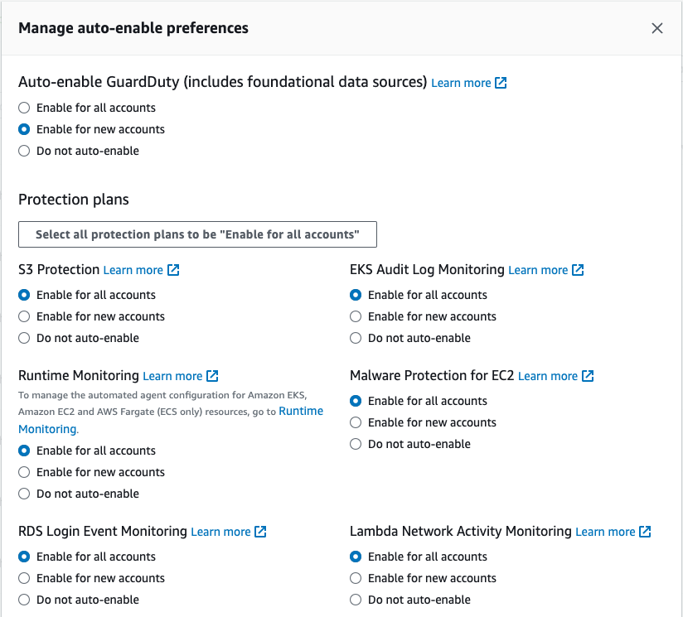
Enable GuardDuty in all Accounts in Your Organization
From the Organization Manager account setup the an account (Security Tooling / Audit) as a GuardDuty Delegated Administrator
Log into the delegated AWS Account and navigate to GuardDuty.
Enable GuardDuty for all accounts in your AWS Organization
Use the auto-enable setting
Repeat for each Region you want to monitor

Slide 27
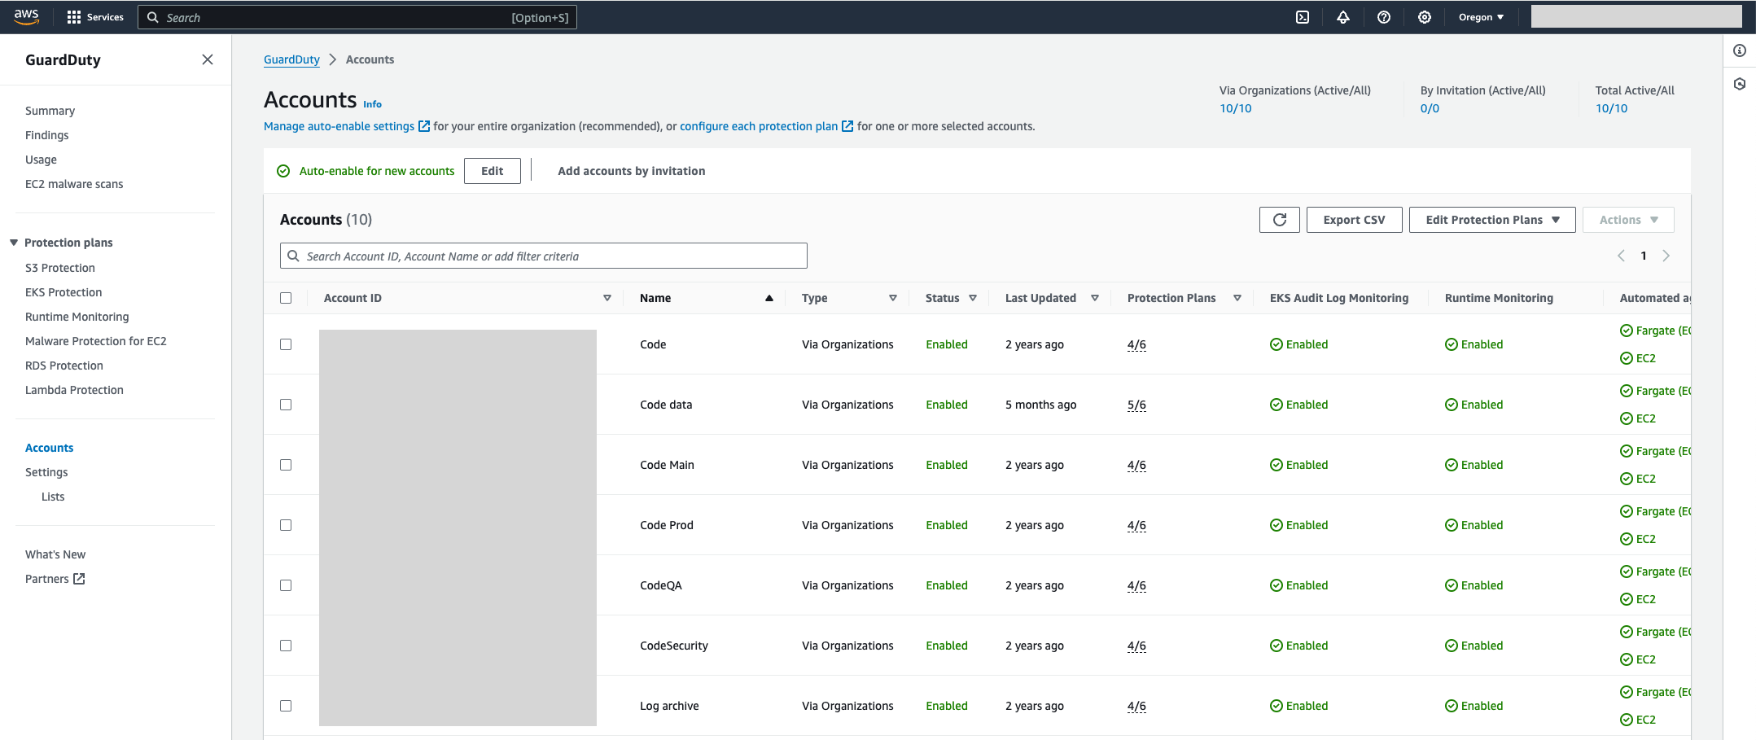
Central account management

Slide 28
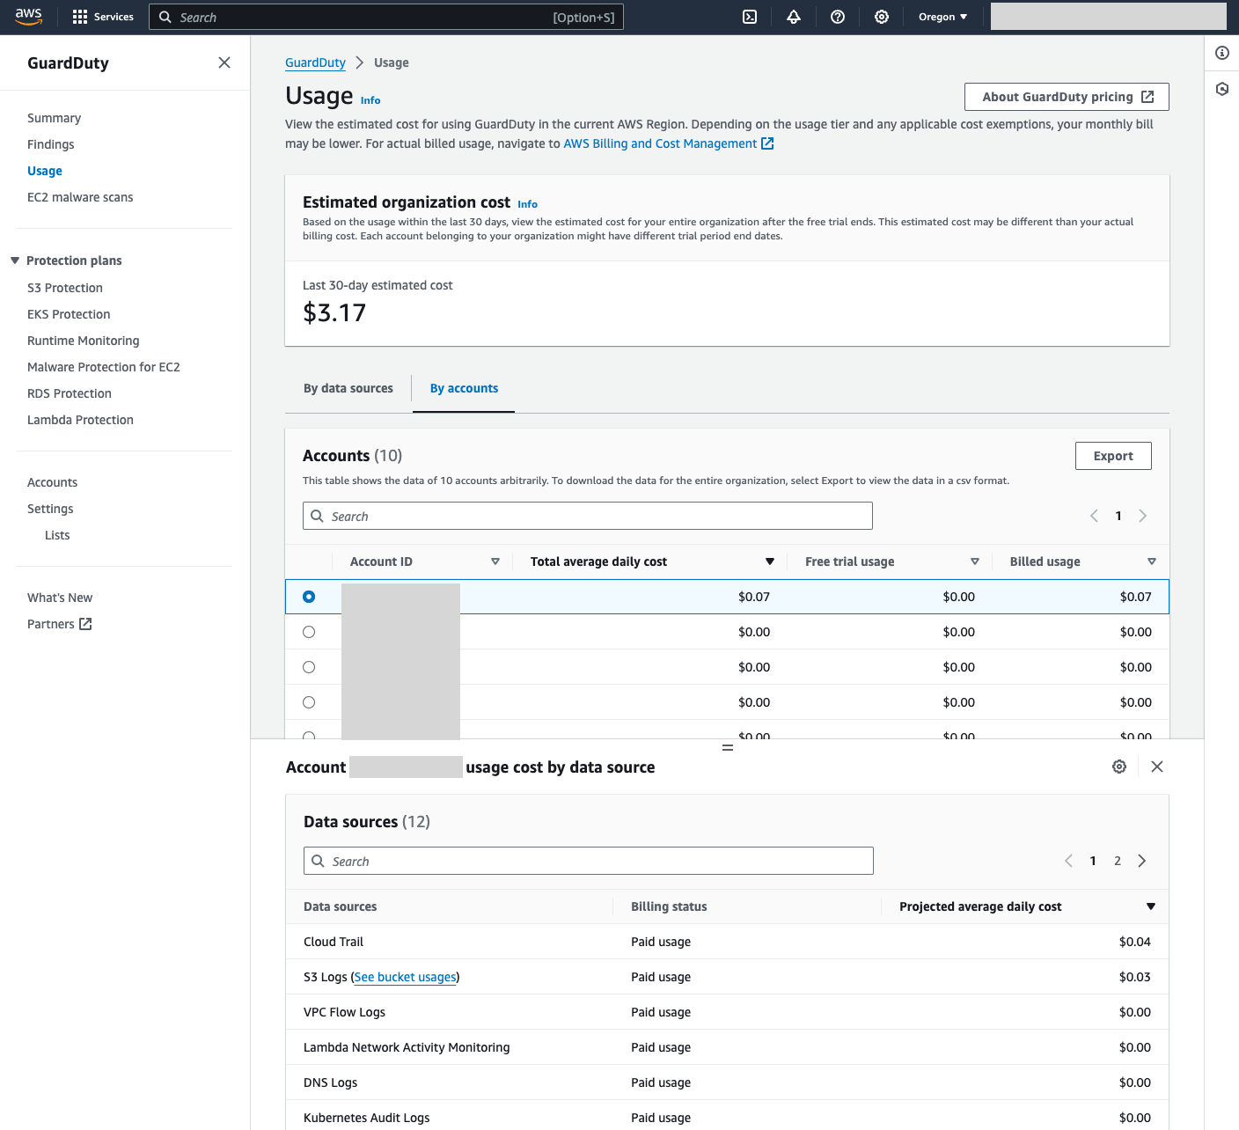
GuardDuty Pricing
All AWS accounts will have a 30-day free trial in each Region.
During the trial, GuardDuty will present the estimated cost.
*Malware Protection free trial is only available for GuardDuty initiated scanning

Slide 29
Amazon GuardDuty – Best Practices
We recommend filtering in a single place, most commonly your enterprise SIEM.
You can pre-filter in GuardDuty to reduce what is being sent to your SIEM but this can lead to confusion if different groups manage GuardDuty and SIEM.
Turn on GuardDuty in all your AWS accounts in all regions and establish a delegated admin/member hierarchy.
Use auto-enable settings to automatically protect new accounts in your organization
Start without a trusted IP list and threat list. Configure only as needed.
Safelist approved vulnerability scanners for brute force findings.
Safelist approved recon-based findings based on port (VPC flow-based).
Automate Risk Mitigation With CloudWatch and Lambda and Set up a notification channel.
Integrate GuardDuty with AWS Security Hub.

Slide 30
Automate Security Checks with AWS Security Hub

Slide 31






What is AWS Security Hub?
Security Hub is a cloud security posture management service that continually performs security best practice checks and seamlessly aggregates security findings from AWS and third-party services to enable automated response
Automated, continuous best practice checks
AWS Foundational Security Best Practices (FSBP) standard, CIS, and more
Simple deployment, scalable up to 10K accounts
AWS and 3rd-party services findings aggregation across accounts and Regions
Automated response, and enrichment actions

Slide 32

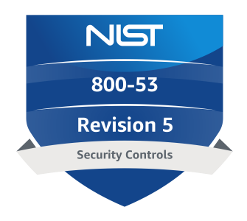




























Security Hub finding flows
Standards and controls
PCI DSS
NIST
AWS FSBP
Security Hub
Remediation actions
CIS AWS Foundations Benchmark
Service-managed standards
AWS Systems Manager
AWS Lambda
AWS Step Functions
Amazon EventBridge
Findings ingestions
Take action with AWS Partners
AWS Config
Amazon GuardDuty
Amazon Inspector
Findings integrations
AWS Identity and Access Management (IAM)
Amazon Macie
AWS Firewall Manager
Amazon Detective
AWS Audit
Manager
Amazon Security Lake
. . . plus many others
. . . and many more
AWS Trusted Advisor
AWS Chatbot

Slide 33
Getting Started
1
2
3
4
Set up log into your AWS account
Enable AWS Config
Enable AWS Security Hub
Enable Security standards and review AWS Integrations
Go to the AWS Management Console and sign in or Create a new AWS account
Open the AWS Config console and choose 1-click setup
Open the Security Hub console and choose Enable Security Hub
Choose additional security standards to align best practices against. Findings from AWS Security services will automatically be ingested.

Slide 34
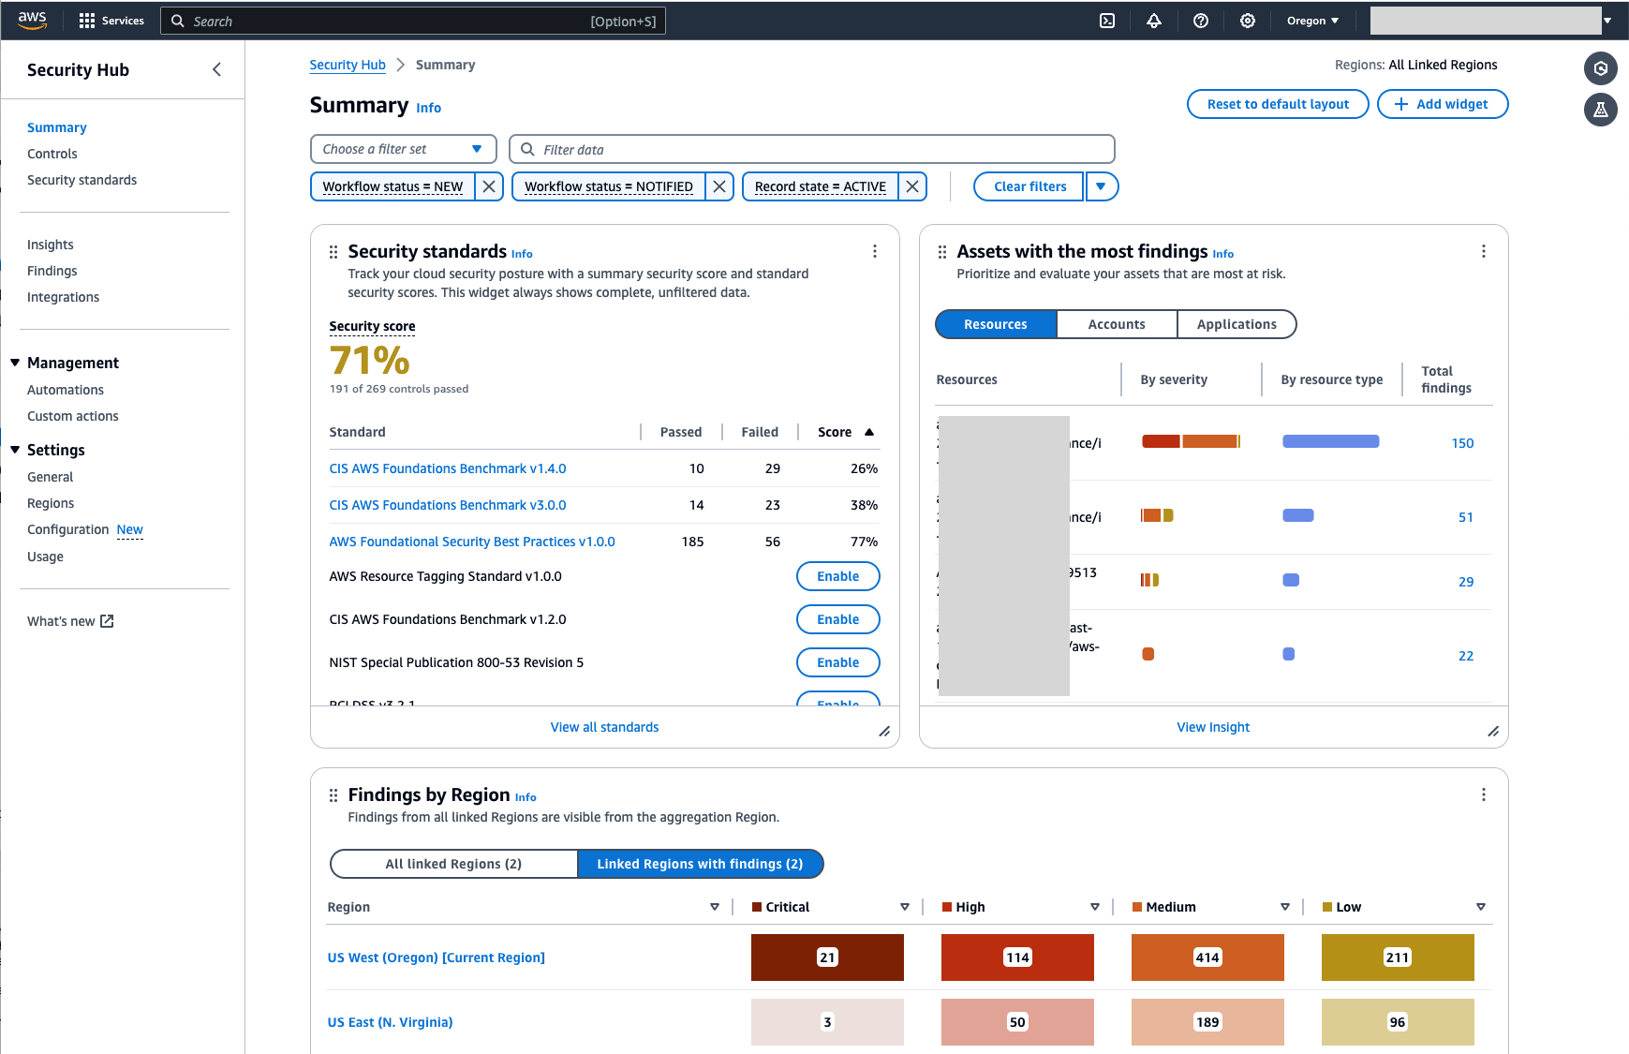
Security Hub dashboard
Overview of alignment to security standards
Assets with the most findings
Findings by each Region (from aggregation Region)

Slide 35
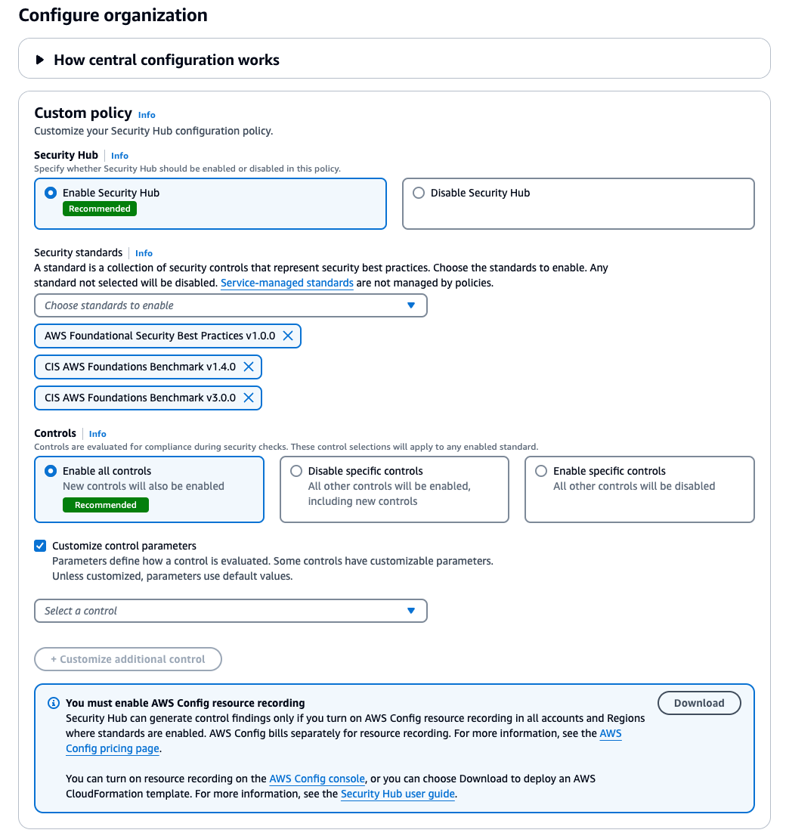
Enable Security Hub in all Accounts in Your Organization
From the Organization Manager account setup the an account (Security Tooling / Audit) as a Security Hub Delegated Administrator
Enable AWS Config in each account and Region (Control Tower does this).
Log into the delegated AWS Account and navigate to Security Hub.
Enable Security Hub for all accounts in your AWS Organization
Use the Central configuration setting
Repeat for each Region you want to monitor. Enable Finding aggregation.

Slide 36
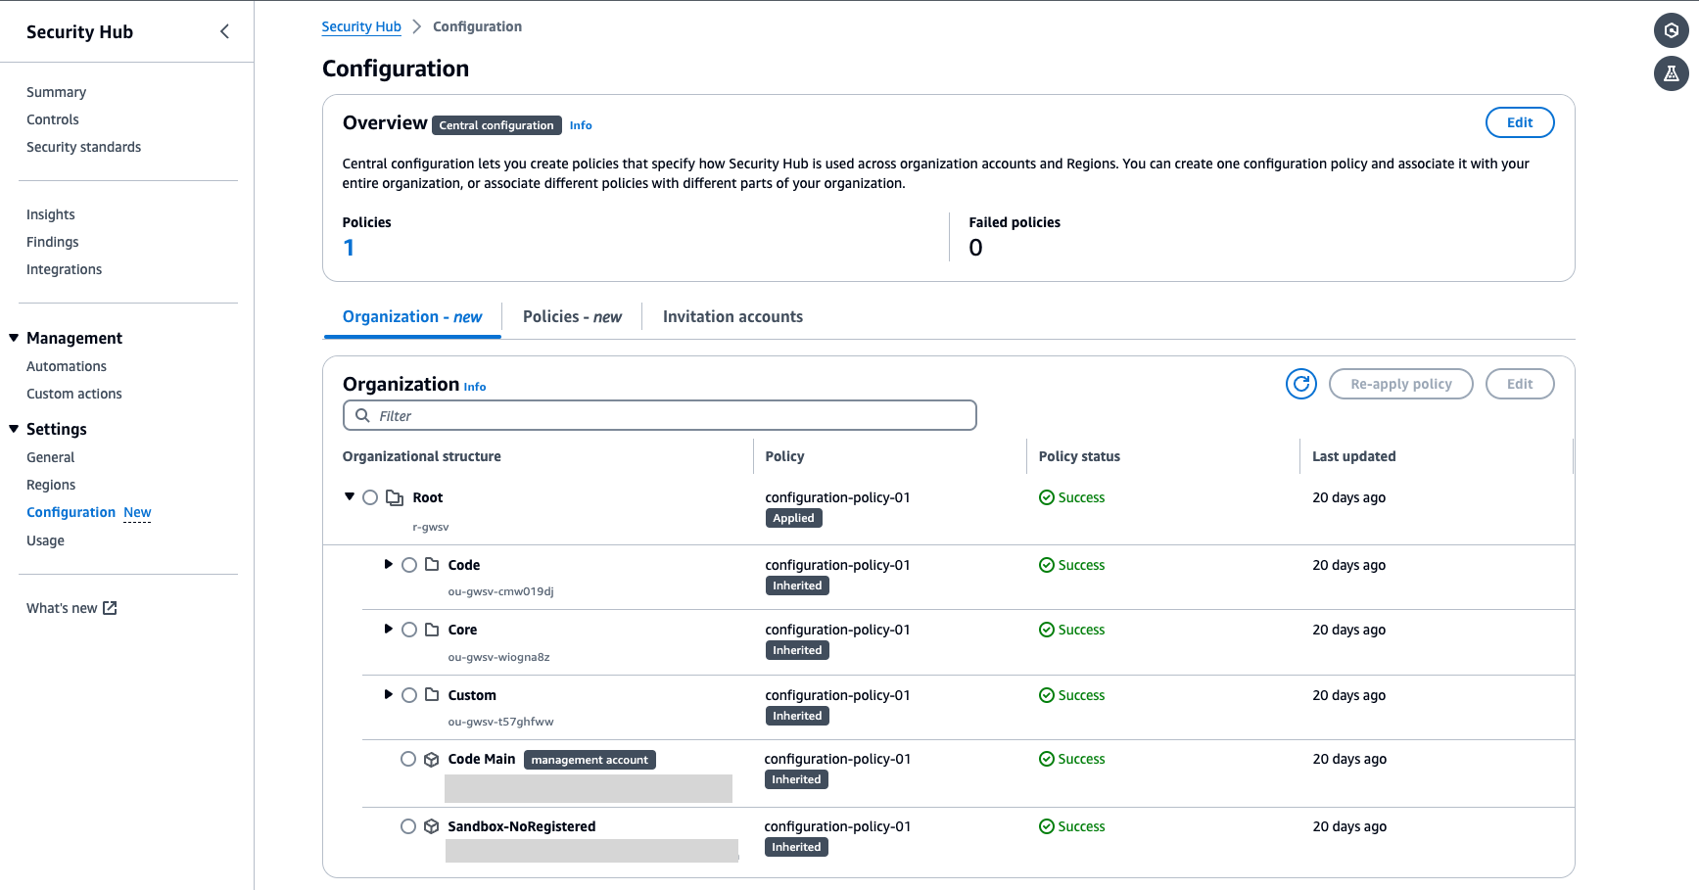
Central account management

Slide 37
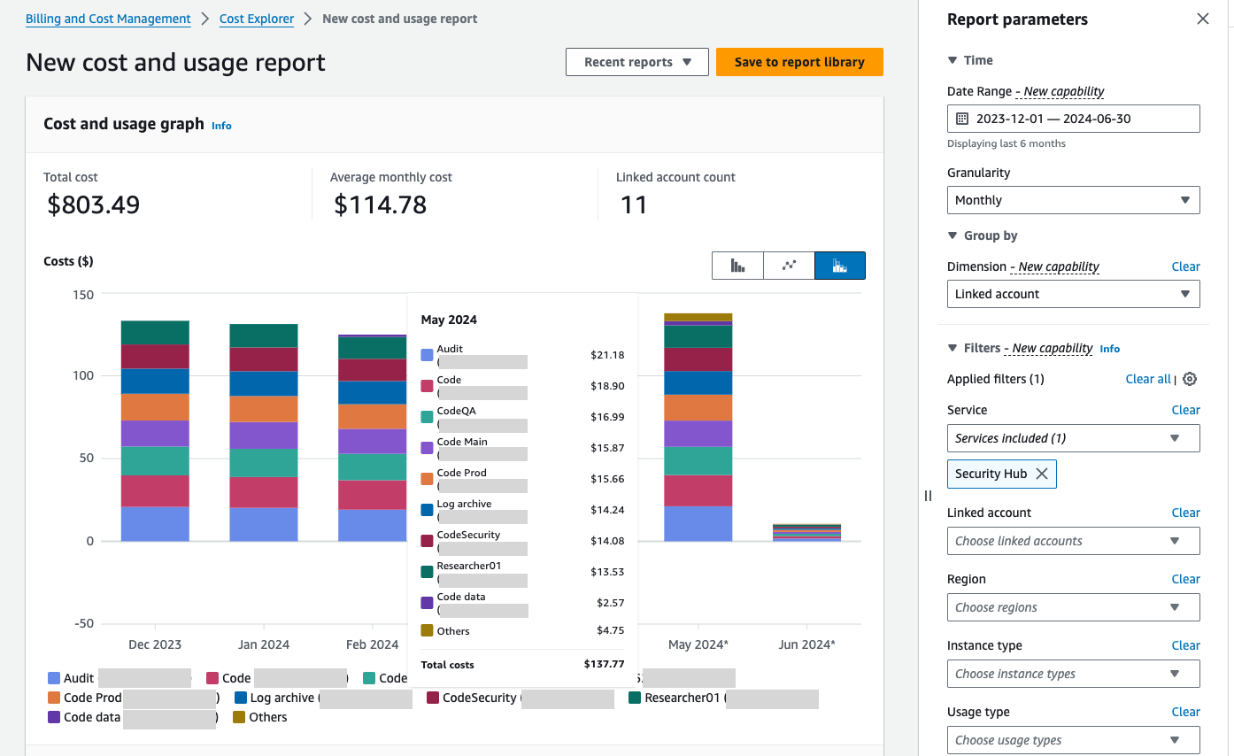
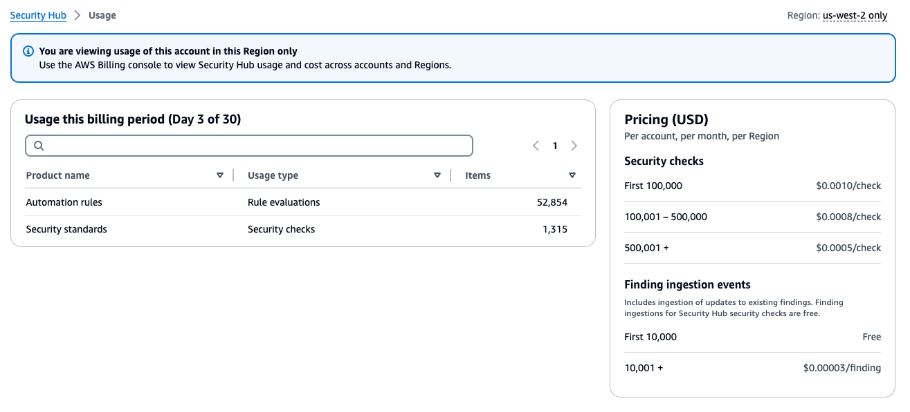
Security Hub Pricing
All AWS accounts will have a 30-day free trial in each Region.
During the trial, Security Hub will present the estimated cost.

Slide 38
Security Hub Best Practices
Turn on Security Hub in all your AWS accounts in all regions and establish a delegated admin/member hierarchy.
AWS Config is a prerequisite for AWS Security Hub. Enable Config in each account and region.
Enable Security Hub standards to align security best practices against.
Use customized control parameters to define how controls are evaluated.
Take action on Critical and High findings.
Use EventBridge for alerts and remediation.

Slide 39
Encrypt Everything: AWS Key Management Service

Slide 40





Encrypt, where? Encrypt everywhere!
Data at rest
Storage encryption
Data in motion
Network encryption
Application Data
Application level encryption
TLS
Application Code
S3 Bucket
Client-side encryption = You encrypt
Server-side encryption = AWS encrypts

Slide 41






















How does AWS help customers with data protection?
AWS Cloud
Client-side encryption to encrypt inbound data
Server-side encryption to encrypt data at-rest
AWS Identity and Access Management – Cross-Account Access
“How do we move our data to AWS securely?”
AWS KMS and CloudHSM for enterprise key management and FIPS 140 validated HSMs
“How do we securely share data and resources within the cloud?”
“How do we keep data on AWS confidential?”
AWS Certificate Manager for SSL/TLS certificates
“How do we manage authentication and authorization?”
Well-Architected Guidance
Available in all Regions
Our services are used by all other AWS services
Cryptographic SDKs for application encryption
Multi-Region Keys for Disaster Recovery
“How do we optimize cost and performance?”
“How do we architect for availability?”
“How do we scale?”
AWS Management & Governance integrations
“How do I prove security and compliance to auditors?”
AWS IAM and Secrets Manager for identity and credentials management

Slide 42


AWS Cryptographic Services
Tools for encryption at rest
Tools for encryption in transit
AWS Certificate Manager (ACM)
AWS Key Management Service (AWS KMS)
AWS Client VPN
AWS Site-to-Site VPN

Slide 43




Encryption using AWS KMS
Over 100 AWS services are integrated with AWS KMS to enable secure key management for encryption of data stored in the service
Integrated services include:
Amazon Simple Storage Service (Amazon S3)
Amazon Elastic Block Store (Amazon EBS)
Amazon Relational Database Service (Amazon RDS)
AWS Lambda
Amazon Simple Storage Service (Amazon S3)
Amazon Elastic Block Store (Amazon EBS)
Amazon Relational Database Service (Amazon RDS)
AWS Lambda

Slide 44
KMS Keys and Data Keys
KMS Keys
Represents the top of a key hierarchy
Non-exportable
Generated on hardware security module (HSM) or imported by the customer
Region specific, globally unique
Multi-region replication supported
Data Keys
Used to encrypt your data
Protected by KMS keys
Stored (as ciphertext) with encrypted data
Generated (or decrypted) by KMS
Do NOT write clear-text keys to durable storage
AWS Key Management Service

Slide 45




KMS key hierarchy
Two-tiered hierarchy for keys
Data keys used to encrypt customer data
KMS keys protect data keys
All activity associated with KMS keys is logged
Benefits of a two-tiered key hierarchy
Envelope encryption avoids managing data keys
Encrypted data keys stored with encrypted objects
AWS KMS acts as root of trust for key management
Key Management Service
KMS Key
Data Key
Data Key
Data Key
S3 bucket
EBS volume
RDS instance

Slide 46
Using KMS Keys and Multi-Region Keys
Three types of KMS keys
AWS Owned
AWS Managed
Customer Managed
Standard KMS keys vs. Multi-Region Keys (MRKs)
By default KMS keys are regional – they can only be used in the region where they are created
Multi-Region Keys can be used in multiple regions, enabling use cases like disaster recovery or Active/Active applications

Slide 47
Customer managed keys give you most flexibility
 | Customer Managed Key | AWS Managed Key | AWS Owned Key
Policy | Customer | AWS | AWS
Audit | Customer CloudTrail | Customer CloudTrail | None
Rotation | Customer | Up to each service | Fixed @ 3 Years
Copy to other regions? | Yes (For MRK keys) | No | Yes (Limited)
Cost | $1 per month and charges on API calls | Charges on API calls | No cost on key or API calls

Slide 48
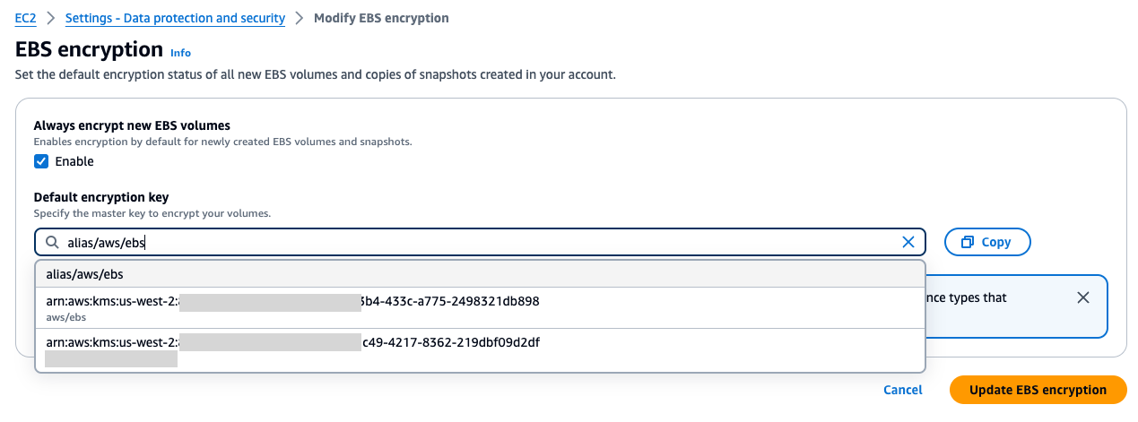
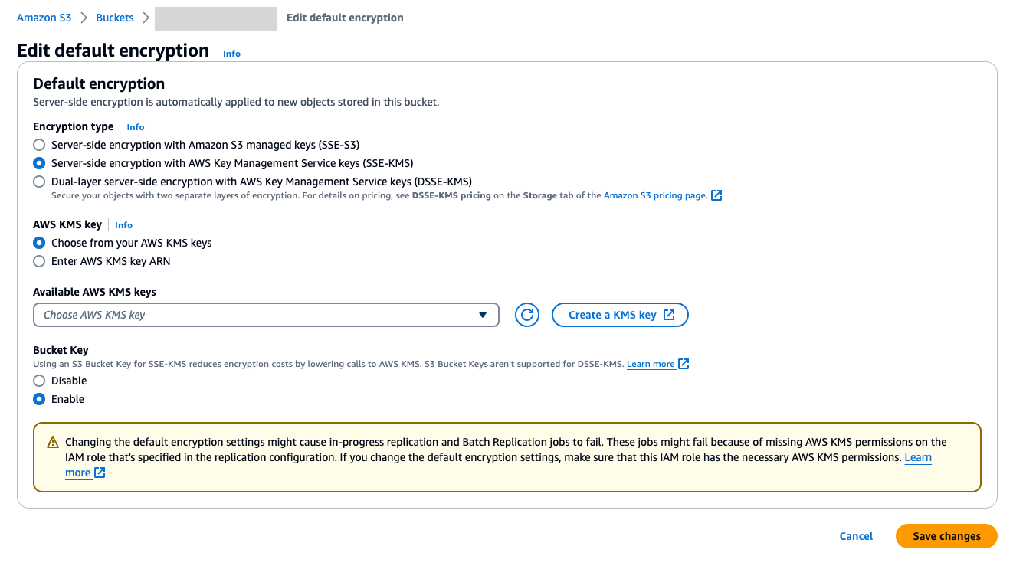
Enable encryption by default

Slide 49







KMS Pricing
Example: Amazon S3 uses 1 KMS key to encrypt 10k files and decrypted 2MM times per month
Each AWS KMS key that you create in AWS KMS costs $1/month (prorated hourly).
AWS KMS provides a free tier of 20,000 requests/month
https://aws.amazon.com/kms/pricing/
Amazon S3 (Calling Service)
Data Key (Plaintext)
Data Key (Encrypted)
Example: Amazon EBS volume for EC2
AWS KMS
Customer Managed Keys (CMKs)
EBS volume
EC2 instance
Data key encrypted under KMS Key
AWS KMS
Key material stored in AWS KMS
$1 / month (KMS key) + $0.03 * 2,010,000 requests
Total = ~$7 / month
$1 / month (KMS key) + $0.03 per 10,000 requests
Total = ~$1 / month

Slide 50
Recommended Actions for KMS
Use AWS Identity and Access Management (IAM) policies in combination with key policies to control access to your customer master keys (CMKs) in AWS KMS.
All KMS keys have a key policy – customer managed keys allow you to customize the key policy for more granular access controls
Use IAM policy for an additional layer of access control
Modify the key policy to meet your requirements, if not using IAM, remove the Enable IAM User Permissions statement block
Separate cryptographic user and administrator permissions
Identify and recover any KMS Customer Master Keys (CMK) scheduled for deletion.
Ensure Amazon KMS master keys are not exposed to everyone.
Ensure KMS key rotation feature is enabled for all your Customer Master Keys (CMK).
Key Management Service (KMS) configuration changes have been detected within your AWS account.
Identify and remove any disabled Customer Master Keys (CMK) to reduce AWS costs.
Enable encryption by default where available.

Slide 51
Protect workloads at the edge with AWS Web Application Firewall (WAF)

Slide 52





AWS WAF (Web Application Firewall)
Frictionless set up: No application changes
Low operation overhead: Ready-to-use, built-in rules
Customizable security: Custom rule engine
AWS WAF
Advanced automation: API driven architecture
Intelligent mitigations: Account Takeover Prevention, Bot Control, Captcha

Slide 53








How AWS WAF works
AWS WAF web ACL
Rule 1
Rule 2
Rule 3
Rule N
Raw request header and body
Inspection
criteria
Logical operation
Inspection
criteria
Logical operation
Inspection
criteria
Logical operation
Inspection
criteria
Logical operation
Amazon
CloudFront
Amazon Cognito
Application Load Balancer
Default action
AWS Verified Access
Action
Action
Action
. . . . . .
Action
Amazon API
Gateway
AWS
AppSync
AWS App Runner
Rules in order
IP match, geo-IP
SQLi, XSS
Rate-based
Etc.
Logs
Sampled requests
Full logging data
Actions
Allow
Block
Count
CAPTCHA/challenge
Header insertion
Custom response
Amazon
CloudWatch
Please Note: Header inspection and Custom response are not Rule actions but an optional step/action that can be done for non-blocking rule actions.

Slide 54
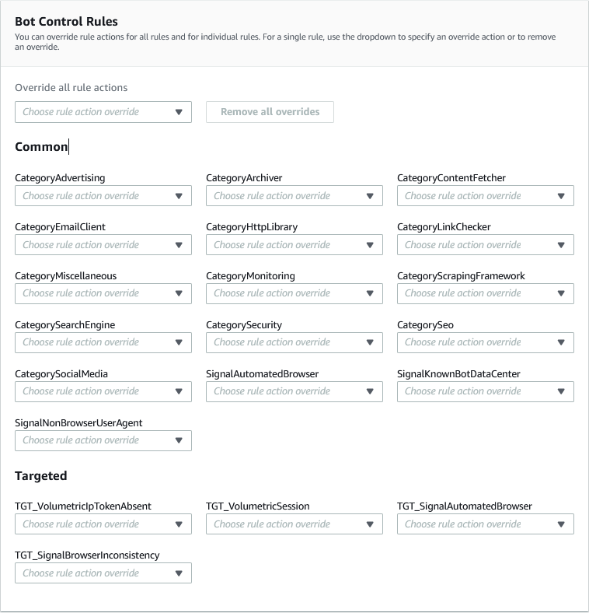
AWS WAF Bot Control
Common bots
Detects self-identifying, simple bots via signature-based detection, IP reputation lists, request headers, and reverse DNS lookup
Targeted bots
Detects bots that try to evade detection with behavior-based detection capabilities and browser fingerprinting and interrogation

Slide 55
How do we detected targeted bots?
Targeted protection level
Creates a fingerprint for every device connecting to the application
Allows tracking across sessions and IP addresses
Generation of a cryptographic token
How tokens are generated?
Application integration SDK requires insertion of a script snippet into your application (recommended)
Challenge or CAPTCHA rule action against all requests that will be inspected by Bot Control rule group (additional cost)

Slide 56



Account Takeover Prevention (ATP) Managed Rule Group
Detect and mitigate against login attempts made by malicious actors using stolen credentials
Monitor and verify credentials
Check to see if user’s credentials have been leaked on dark web
Prevent automated login attempts from bots
Stop attacks like brute-force and credential stuffing
Can also inspects your application's responses to login attempts, to track success and failure rates

Slide 57
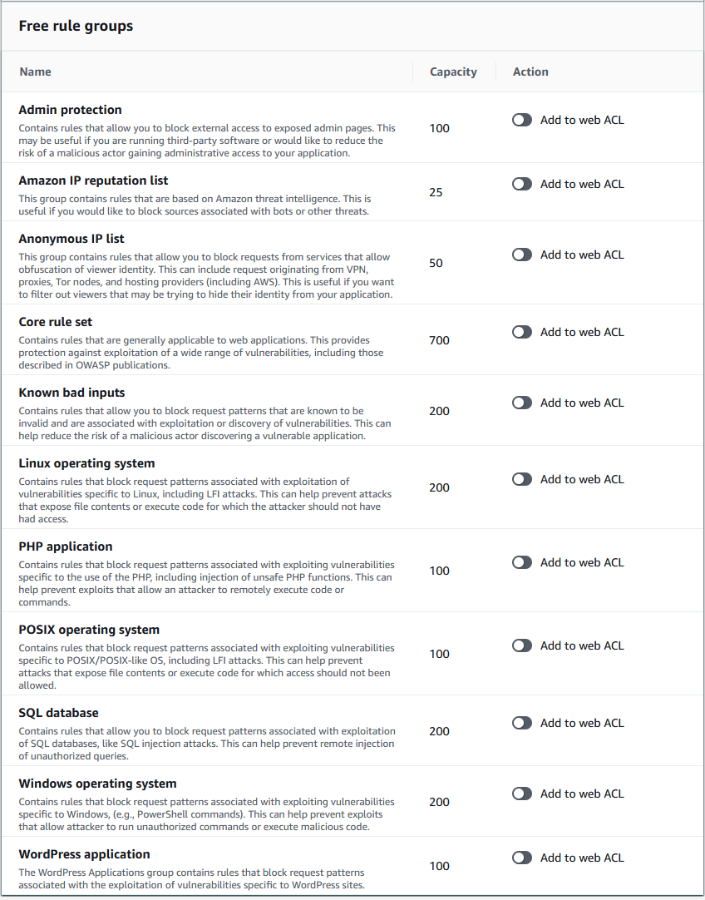
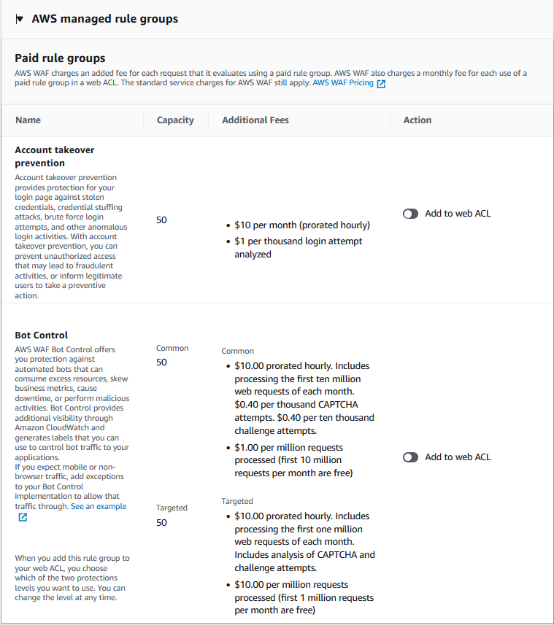
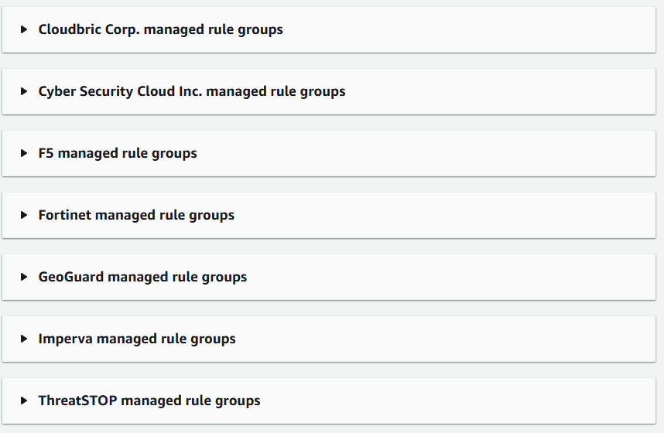
AWS Managed Rules: Three types
AWS free
AWS paid
AWS Partner paid

Slide 58
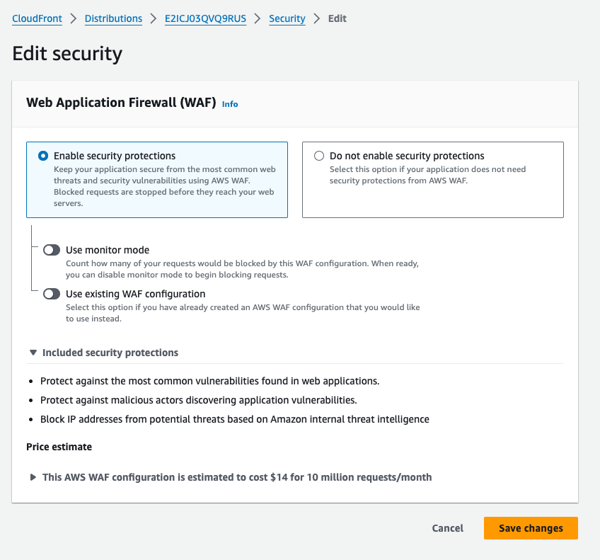
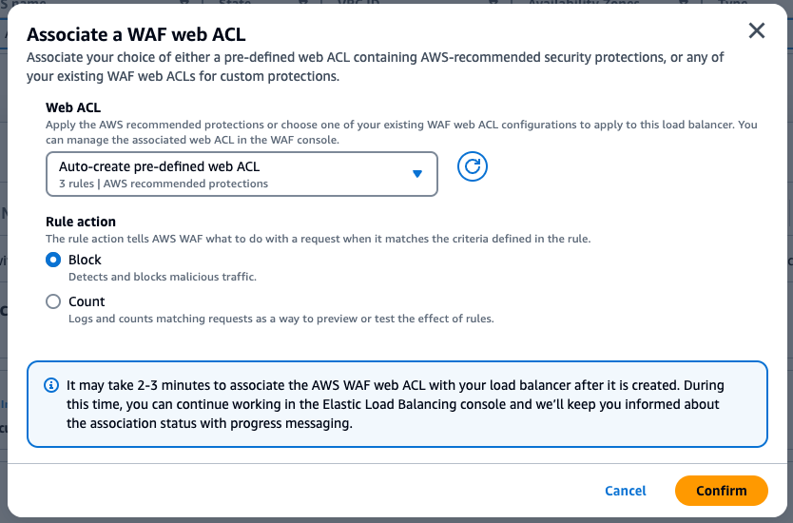
Enable AWS WAF
Get started in a few clicks with best practice defaults for Application Load Balancers (ALB) and CloudFront
Customize WAF based on your requirements

Slide 59
Recommended Actions for AWS WAF
Start new rules in Count Mode before switching to Block Mode when deploying to production.
Use AWS Firewall Manager to deploy WAF ACL rules across the organization.
Periodically monitor and review the application after you deploy AWS WAF.
Rule actions can be terminating or non-terminating.
A single web ACL can be associated with one or more AWS resources, but each AWS resource can have only one web ACL (One to many relationship).
Use WAF rules to determine which requests are evaluated by AWS Bot Control (ABC)
Bypass ABC for traffic not affected by bots (for example, images)
Managed ABC usage based costs

Slide 60
Next Steps: Continuous Security Improvements

Slide 61
Build a Roadmap to Improve Security Health
Scenario | Next Steps | Additional information
Need to go deeper into core AWS services? | Register for an Immersion Day or Security Activation Day | No additional cost
Need to go deeper into Best Practices? | Enterprise Support: Request a Security Improvement Program (SIP) engagement* AWS Security Hub 30-day Free Trail | *Security Improvement Program (SIP) is an Enterprise Support Entitlement Security Hub pricing
Need to go deeper in multi-account AWS environments? | Review the Security Reference Architecture (SRA) and AWS Control Tower | Control Tower Pricing
Prefer fully-managed security services? | Contact MSSP Security Competency Partners | MSSP Partners
Need help from a Systems Integrator? | Contact Security Competency Partners | Security Competence Partners
Prefer AWS Professional Services? | Contact your Professional Services to learn more | AWS Professional Services

